Slide 1
Lecture 8: Zero-order ultrasensitivity

Slide 2
Today’s Outline
Signaling systems
MAP kinase cascades
Amplification
Zero-order ultrasensitivity
Meet the players, Koshland and Goldbeter
Sharp transitions in kinase/phosphatase loops
Dynamics
Background info for discussion paper 2
Fruit fly (Drosophila melanogaster) development
Searching for the source of a sharp boundary

Slide 3
Extracellular signaling molecules bind to transmembrane receptors
Example:
Neuronal signaling
at synapses
Transmembrane receptor
Outside
Inside
Membrane

Slide 4
Extracellular signaling molecules bind to transmembrane receptors
Example:
Neuronal signaling
at synapses
Neurotransmitter binding to receptors caused a conformational change and channel opening
Outside
Inside
Membrane

Slide 5
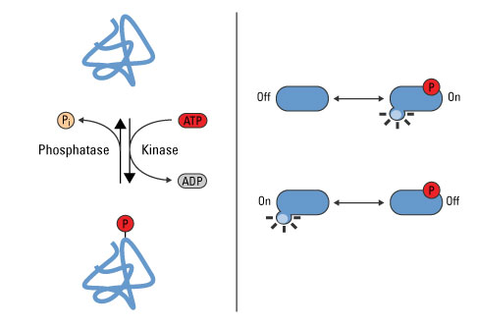
Some receptors are kinases that are activated or inactivated by binding
Recall that kinases are enzymes which put a phosphate group on a target (often, another protein)
Extra phosphate groups can cause the target to change shape: it could become either more or less active

Slide 6
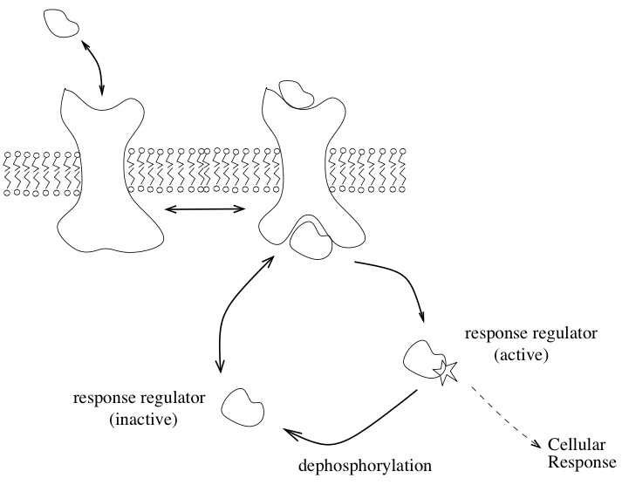
Some receptors are kinases that are activated or inactivated by binding
Example: bacterial two-component signaling.
The receptor is a kinase that becomes active only when ligand is bound.
The kinase phosphorylates a response regulator (often, a transcription factor) on the inside of the cell.
The response regulator is then active and causes a cellular response to the signaling.

Slide 7
In many cases receptor binding initializes a signaling cascade
The bound receptor activates protein A
Protein A activates protein B
Protein B activates protein C
etc. etc.

Slide 8
Example: MAP Kinase Cascades
Indirect input from a bound receptor
MAPKKK
MAPKKK*
MAPKK
MAPKK*
MAPK
MAPK*
Output

Slide 9
Do these cascades serve a purpose?
Amplification
Each enzyme can activate many targets before being inactivated.
Crosstalk
Each intermediate

Slide 10
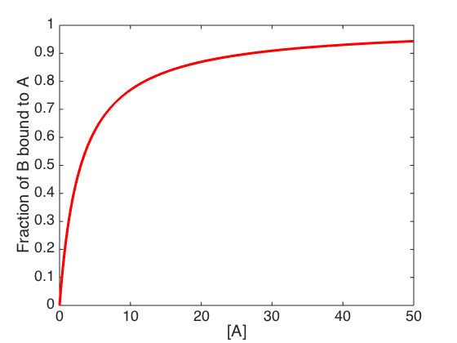
An eighty-one-fold change in concentration is required to change from 10% to 90% activity for Michaelis-Menten kinetics and simple binding curves
Notes:
In their original language Goldbeter and Koshland defined this as needing less than an 81-fold change to go from 10% to 90%.

Slide 11
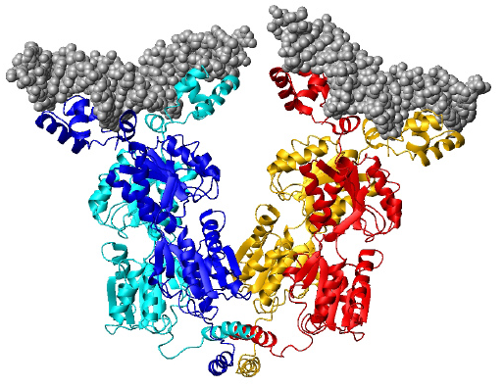
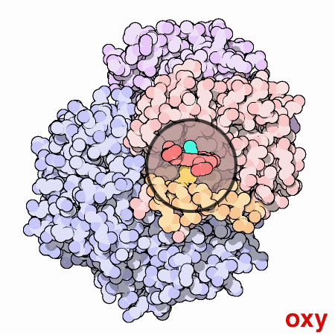
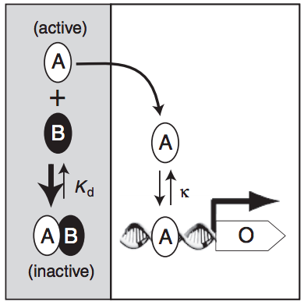
Ultrasensitivity is a general term for responses sharper than M-M kinetics
You have seen several examples already:
Cooperativity (including through tethering)
Concerted structural changes (MWC)
Sequestration by an inhibitor
Notes:
In their original language Goldbeter and Koshland defined this as needing less than an 81-fold change to go from 10% to 90%.

Slide 12
Goldbeter and Koshland’s zero-order ultrasensitivity
Notes:
People used to think that multiple binding sites were necessary for creating sharp transitions in biology; it’s not so as you have seen already, but the system they studied is different from sequestration.

Slide 13
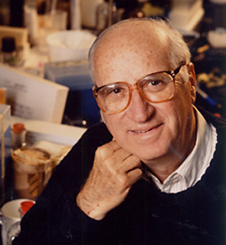
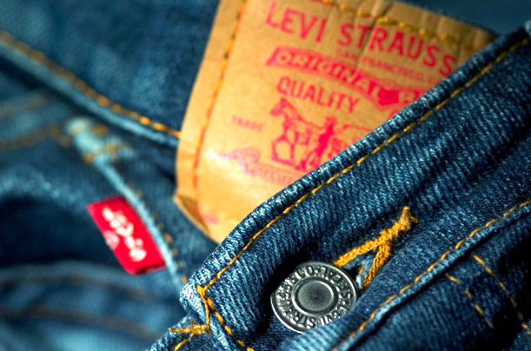
Daniel Koshland
Notes:
Q. What’s the difference between a professor and a pizza? A. A pizza can feed a family of four.
There is some truth in this: many scientists “farm until the money runs out.” But Koshland was a member of a dying breed: the gentleman scientist. Koshland’s father was CEO of Levi’s (the jean company). His own net worth was once estimated by Forbes at $800 million. By comparison most R01s (NIH’s main funding avenue) are $1-3 million dollars.

Slide 14
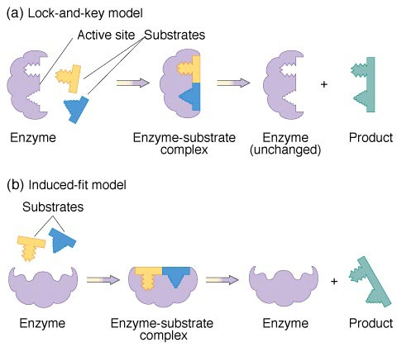
Daniel Koshland
Notes:
A lot of scientists have to “farm until the money runs out”. Have any of you ever heard of a “gentleman scientist”? Koshland’s father was CEO of Levi’s (the jean company). His own net worth was once estimated by Forbes at $800 million. Did his postdoc here at Harvard and became interested in how enzymes work. Unlike Emil Fisher, who envisioned enzymes
Also an editor of Science.

Slide 15
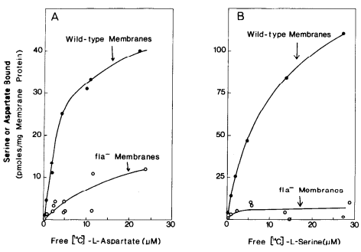
Daniel Koshland
Notes:
Koshland later became interested in the problem of bacterial chemotaxis, that is, how bacteria manage to move towards regions with more nutrients like the amino acids serine and aspartate. We’ll talk a bit more about that system in a few weeks. Koshland’s lab found the receptors that bacteria use to detect those amino acids – this environmental sensing is the first step in chemotaxis.

Slide 16
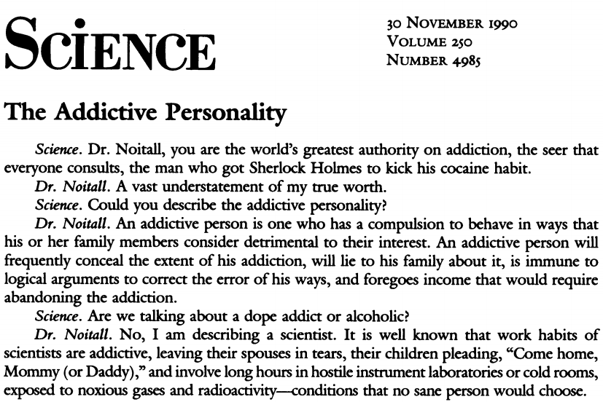
Daniel Koshland
Notes:
Also an editor of Science. Back when he joined, Science editors were all former English students; now most of them are Ph.Ds., largely due to his influence. Wrote 200 editorials starting in 1984. Editorials are pretty drab nowadays, but his were frequently humorous or fictional. Many featured interviews with the imaginary Dr. Noitall.

Slide 17
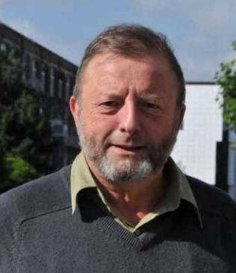
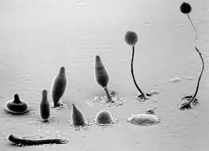
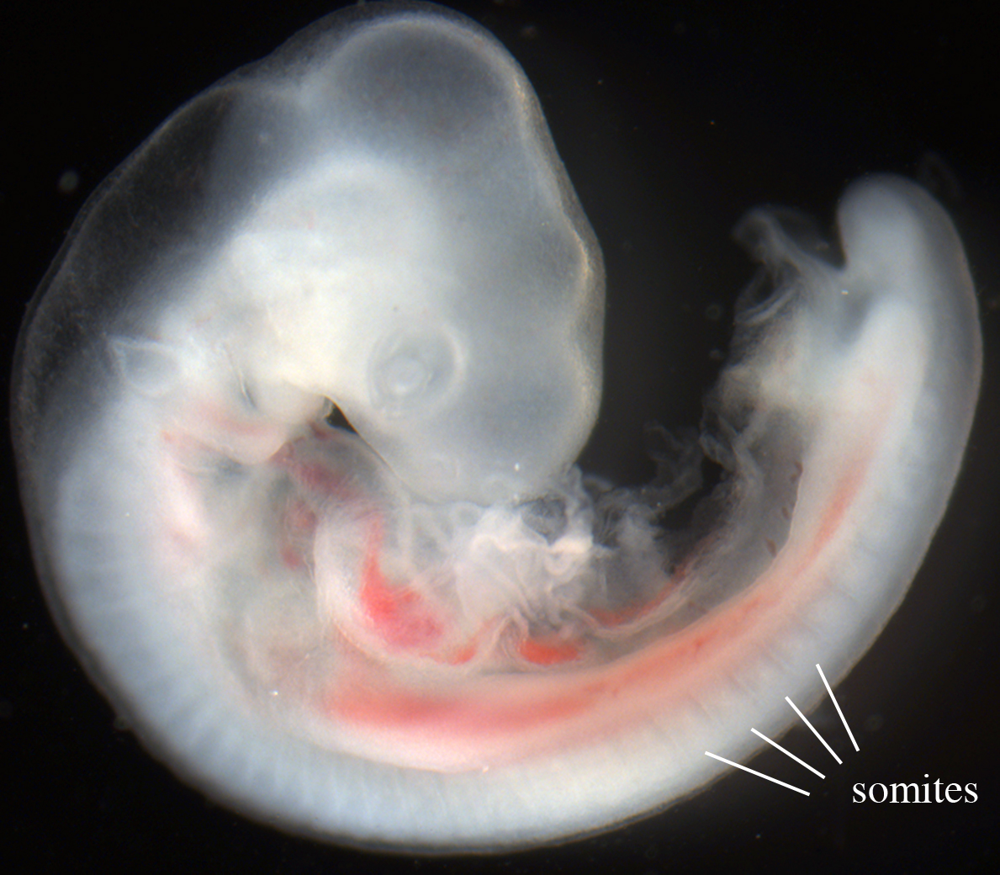
Albert Goldbeter

Slide 18
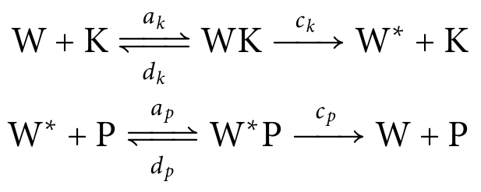
A kinase/phosphatase loop
K
W
W*
P
Suppose both the kinase K and the phosphate P follow Michaelis-Menten kinetics.
How will the ratio of W:W* change as [K] and [P] are varied?

Slide 19
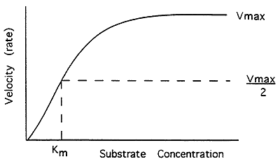
A kinase/phosphatase loop
We’ll make one
(more) simplifying assumption:
[W_{tot}] >> [K_{tot}], [P_{tot}]
[W_{total}] ≈ [W] + [W*]
Enzymes operate at saturation (i.e., in their zero-order regime)

Slide 20
A kinase/phosphatase loop
K
W
W*
P
Our approach:
Assume [W] and [W*] are at steady-state
i.e., c_{k} [WK] = c_{p} [W*P]
Find expressions for [WK] and [W*P]
Rearrange to find the fraction of W in the modified state,
f = [W*]/[W_{total}]

Slide 21
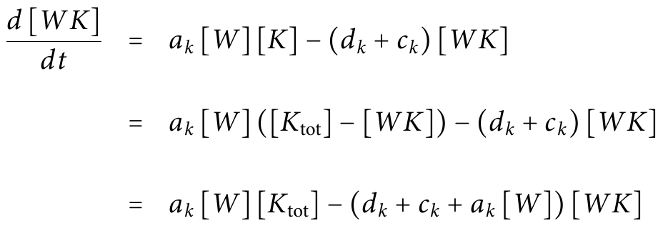
Find expressions for [WK] and [W*P] like we did for Michaelis-Menten kinetics

Slide 22
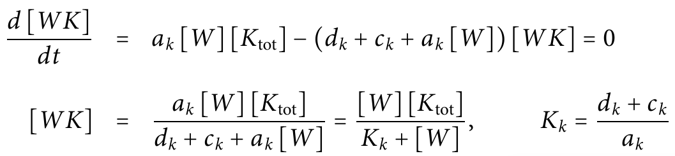
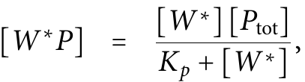
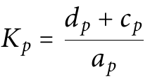
Find expressions for [WK] and [W*P] like we did for Michaelis-Menten kinetics
When [WK] is at steady-state,

Slide 23
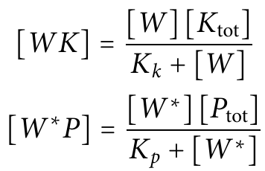
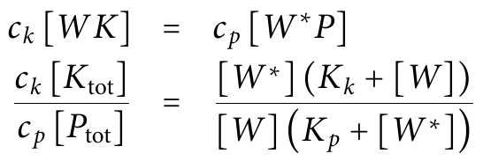
Assume [W] and [W*] are also at steady-state
Kinase
W
W*
Phosphatase

Slide 24
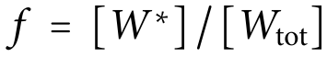
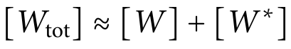
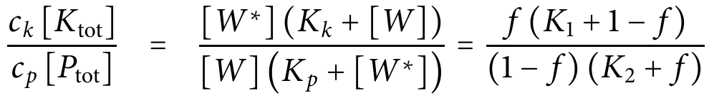
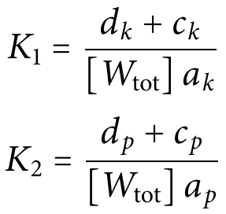
Find an implicit expression for the fraction of W in the modified state
Assumption: [W_{total}] >> [K_{total}], [P_{total}]
Notes:
As you can imagine this can be rearranged into a quadratic

Slide 25
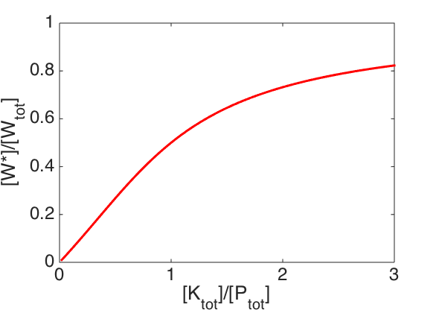
What do we expect to happen when [K_{tot}] and [P_{tot}] are varied?
Kinase
W
W*
Phosphatase
Notes:
As you can imagine this can be rearranged into a quadratic

Slide 26
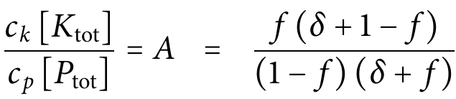
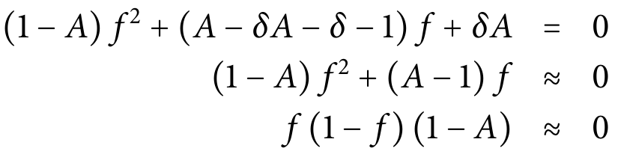
What do we expect to happen when K₁ and K₂ are small?
f ≈ 0 or 1

Slide 27
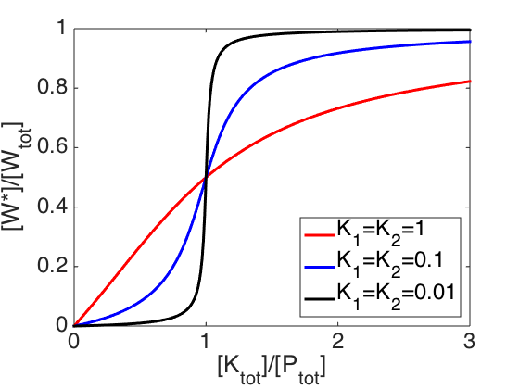
What do we expect to happen when K₁ and K₂ are small?
K₁, K₂ are small when [W_{tot}] is large (which we assumed!)
Notes:
In other words, K1, K2 small when Wtot is very large. Fortunately this is the exact assumption we already made!

Slide 28
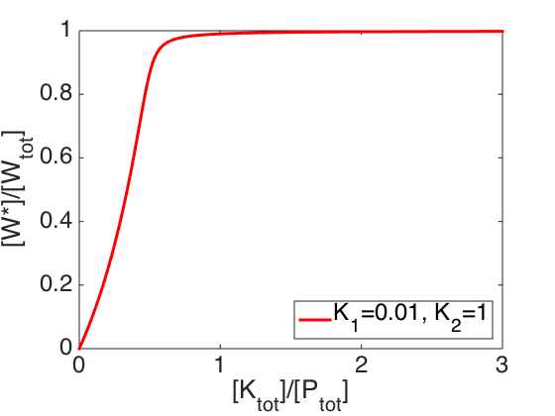
What if only one enzyme is saturated (either K₁ or K₂ is small)?
Note that this still meets the definition of ultrasensitivity
Notes:
In other words, K1, K2 small when Wtot is very large. Fortunately this is the exact assumption we already made!

Slide 29
What is the effect of a cascade?
Input
Suppose all MAPK_{n}s map an input – the amount of active kinase -- to an output fraction of phosphorylated MAPK_{n} by similar functions f_{i}(x).
MAPKKK
MAPKKK*
MAPKK
MAPKK*
MAPK
MAPK*
[MAPKKK*] = f₁(Input)
[MAPKK*] = f₂([MAPK*] )
[MAPK*] = f₃([MAPKK*]) = f₃(f₂(f₁(Input)))
Output

Slide 30
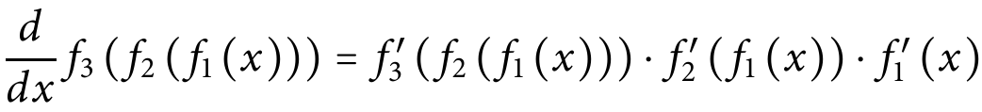
What is the effect of a cascade?
How steep is the overall output f₃(f₂(f₁(x))) relative to these functions alone?
When all three functions have slope greater than unity, the overall slope is even steeper
When all three functions have slope less than unity, the overall slope is more gradual
→ This creates an even more ultrasensitive curve!
Notes:
Our current expression for this function is implicit.

Slide 31
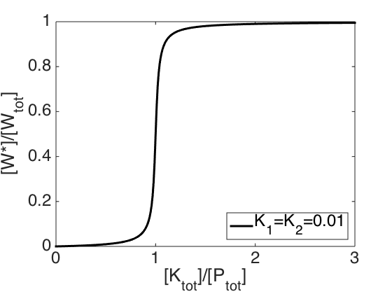
Suppose I increase [K_{tot}] to move from just below to just above the threshold:
How long until the output transitions?
Notes:
Our current expression for this function is implicit.

Slide 32
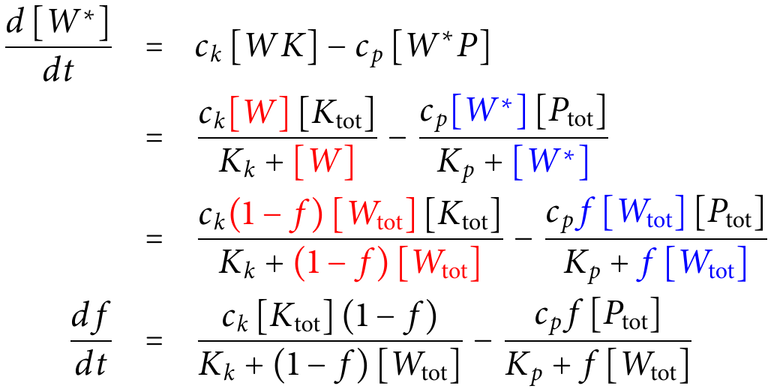
The downside (?) of zero-order ultrasensitivity: slow transitions
Notes:
Our current expression for this function is implicit.

Slide 33
Discussion Paper #2: Melen et al., 2005
Primer on Drosophila (fruit fly)
development and genetics

Slide 34
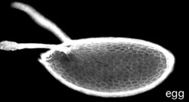
The first major problem in fruit fly embryogenesis: axis specification
Dorsal
(back)
Anterior
(head)
Posterior
(tail)
Ventral
(stomach)
Notes:
The egg is about half a millimeter long. Need to explain the basics of their development.
One these things are figured out it can become a little more specific.

Slide 35
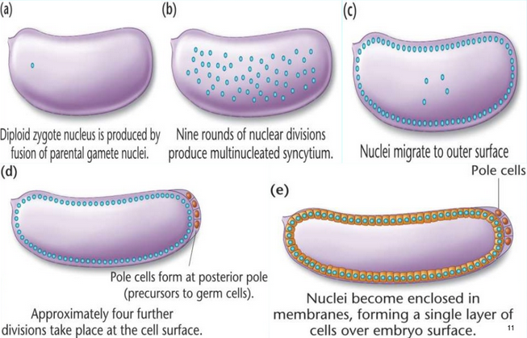
Following fertilization, a surface layer of cells forms

Slide 36
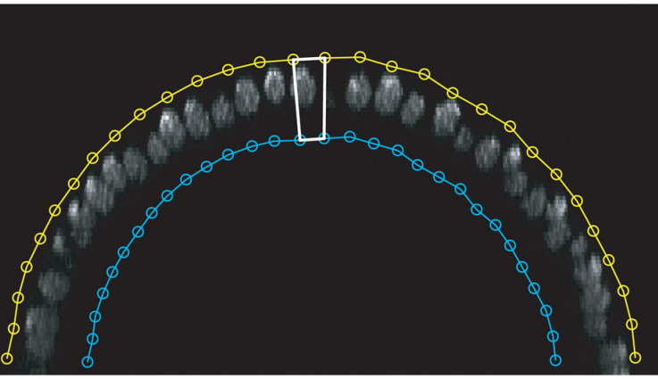
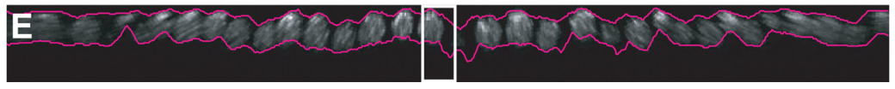
Why is Drosophila DV patterning a convenient model system?
Simple geometry and easy imaging

Slide 37
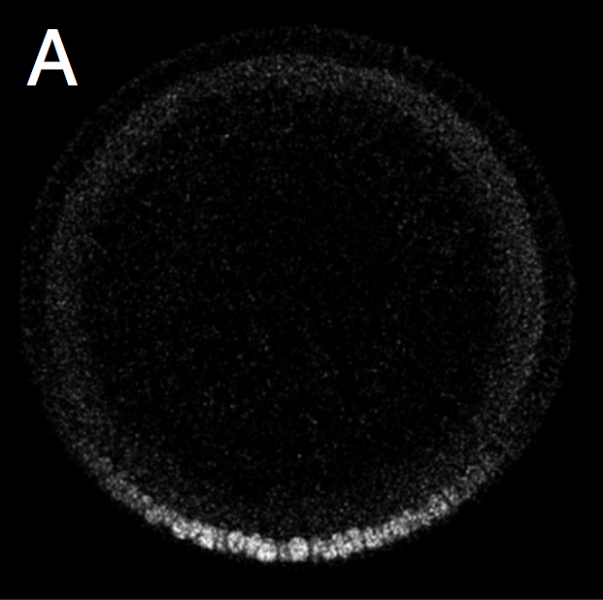
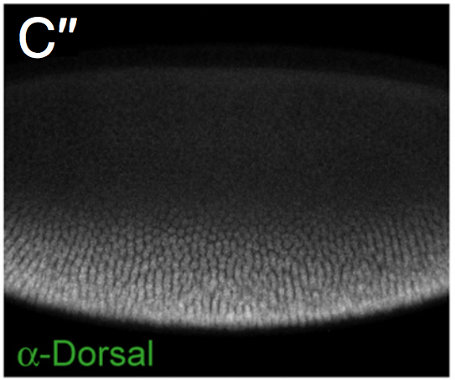
Dorsoventral gradient of active Dorsal (a transcription factor) in the early embryo
Dorsal
Dorsal
Ventral
Ventral
Liberman et al., 2009
Notes:
Explain the nomenclature of mutants in Drosophila (called Dorsal because if you knock it out, the whole embryo developss like the embryo’s back.
Don’t give the impression that this gradient is static.

Slide 38
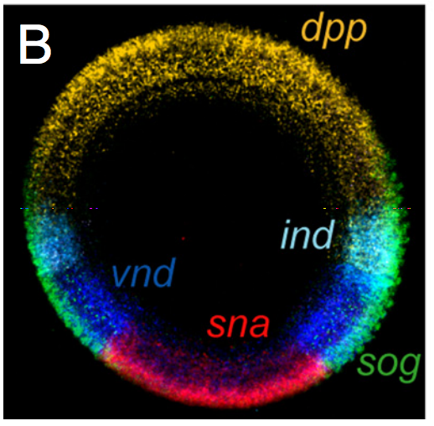
Dorsal has many target genes, and their activation thresholds differ
Liberman et al., 2009
Sharp expression boundaries are created through cooperativity in Dorsal binding (and downstream interactions)

Slide 39
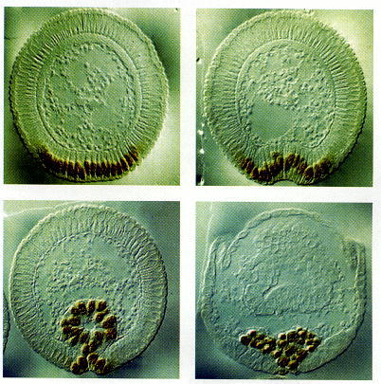
The most ventral cells buckle inward and become mesoderm, forming muscles, heart, etc.
Gilbert 7th ed.

Slide 40
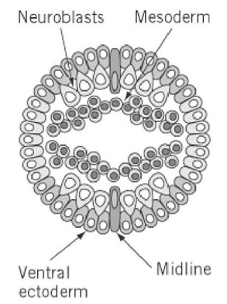
Cells that remain at the surface form ectoderm, e.g. the nervous system and epidermis (skin)
The ventral midline cells secrete a morphogen called Spitz.
Spitz reaches different concentrations depending on the distance from the midline.
Cells determine their fate based on the [Spitz] they detect.
Notes:
This is not the end of dorsoventral patterning, however. The cells remaining at the surface contribute both to the nervous system and to the “skin”, if you will, of the embryo. They decide whether to become skin or neurons based on the concentration of a morphogen that they sense.
Emphasize that this is where the focal point of the paper will be.
http://what-when-how.com/molecular-biology/drosophila-egf-receptor-molecular-biology/

Slide 41
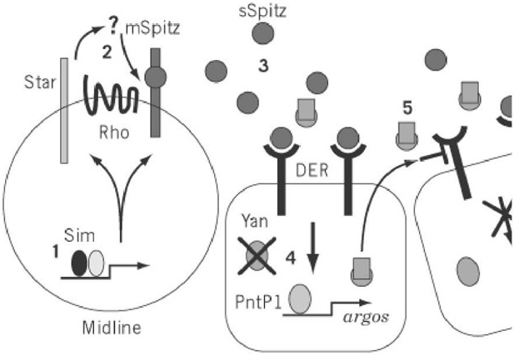
A transcriptional repressor, Yan, is degraded when [Spitz] is high

Slide 42
[Spitz] binds its receptor
Spitz
Receptor
(EGFR)
MAPK
(ERK)
Phosphatase
Yan

Slide 43
Bound receptor activates MAPK (ERK) through a MAP kinase cascade
Spitz
Receptor
(EGFR)
MAPK*
(ERK)
Phosphatase
Yan

Slide 44
Active MAPK (MAPK*) binds Yan and phosphorylates it
Spitz
Receptor
(EGFR)
MAPK*
(ERK)
Phosphatase
Yan*

Slide 45
Active MAPK (MAPK*) binds Yan and phosphorylates it (Yan*)
Spitz
Receptor
(EGFR)
Might phosphorylate multiple sites
(significance?)
MAPK*
(ERK)
Phosphatase
Yan*

Slide 46
Yan* is degraded (unless a phosphatase removes the phosphate)
Spitz
Receptor
(EGFR)
MAPK*
(ERK)
Phosphatase
Yan

Slide 47
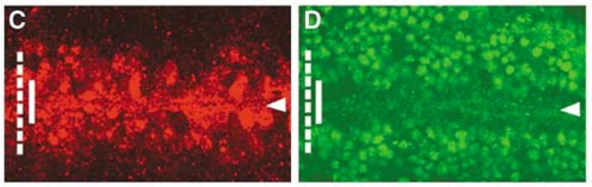
The [Spitz] gradient is broad, but the pattern of Yan degradation is sharp
Signal from Spitz
Yan
Notes:
http://what-when-how.com/molecular-biology/drosophila-egf-receptor-molecular-biology/

Slide 48
Melen et al. consider several potential sources of ultrasensitivity
First-order
One phosphorylation is enough for Yan degradation
Cooperativity
need multiple phosphates on Yan for degradation
Zero-order ultrasensitivity
(Unidentified) positive feedback

Slide 49
Why is Drosophila DV patterning a convenient model system?
The classic way of expressing a gene at an unusual location or time during development
Promoter regions
(contain TF binding sites)
Create new, hybrid gene with Gene A’s promoter and Gene B’s coding sequence
Gene A
Gene B
Gene B
The protein B will be expressed at the same time and place as protein A
Coding regions
of the genes
Notes:
This is effective, but there are way too many potential combinations or promoters and coding regions. The fruit fly has 17,000 genes.

Slide 50
Why is Drosophila DV patterning a convenient model system?
Can create these combinations quickly using a synthetic gene library in Drosophila
The Gal4 protein is a transcriptional activator which binds a site called “UAS”.
Similarly, many hybrid genes exist with UAS upstream of different coding regions
Prom_{A}
GAL4
UAS
A
.
.
.
.
.
.
Prom_{Z}
GAL4
UAS
Z
Many hybrid genes exist with GAL4’s coding region under different promoters

Slide 51
Why is Drosophila DV patterning a convenient model system?
Can create these combinations quickly using a synthetic gene library in Drosophila
Just breed flies with the GAL4 gene and UAS gene of your choice
Gal4 protein is expressed wherever gene A is expressed.
Gal4 binds UAS and activates gene expression.
Therefore, protein Z is expressed wherever gene A is expressed.
Prom_{A}
GAL4
UAS
Z

Slide 52
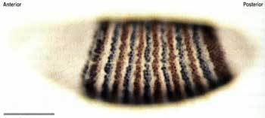
Why is Drosophila ventral patterning a convenient model system?
For example, we can test hypotheses by expressing a gene in stripes.
We look for differences between the gaps (where everything should be normal) and the stripes.

Slide 53
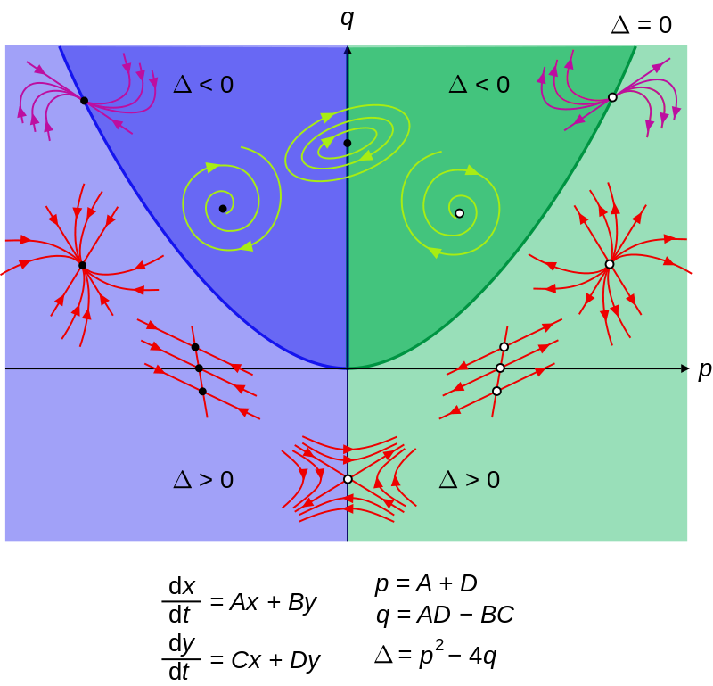
Next time: Phase plane and stability analysis
Too many biological minutiae for your taste?
Great news!

